Slide 1
Full-Stack Web Development Lecture 8: Making API requests in VueJS Ashley Williams Ashley.Williams@mmu.ac.uk

Slide 2
Learning Objectives
To understand:
How we can make API interaction from within our applications
How we can handle authentication on the front end
Technically, everything that is needed to implement all functionality for this unit

Slide 3
Unit Overview
# | W/C | Lecture | Lab
1 | 03/10/2022 | Introduction to Full-Stack | Recap/RESTful APIs
2 | 10/10/2022 | Introduction to NodeJS/ExpressJS | Getting started with NodeJS/ExpressJS
3 | 17/10/2022 | Interacting with Databases | Interacting with Databases
4 | 24/10/2022 | Handling Authentication | Handling Authentication
5 | 31/10/2022 | Version Control | Assignment Support: Backend
6 | 07/11/2022 | API Security and Scaling | Assignment Support: Backend
7 | 14/11/2022 | Introduction to VueJS | VueJS Basics
8 | 21/11/2022 | Networking | Handling API requests
9 | 28/11/2022 | Style, Layout, and Navigation | Layout and Navigation
10 | 05/12/2022 | Structuring and Refactoring | Assignment Support: Front-end
11 | 12/12/2022 | Code Quality | Assignment Support: Front-end

Slide 4
Where are we up to?
Back end application is complete
Front end:
We have an app
We have router and two pages (“/” and “/login”)
We have a method for implementing access control
We know how to create and validate form data
Now it is time for our two applications to interact with each other…

Slide 5
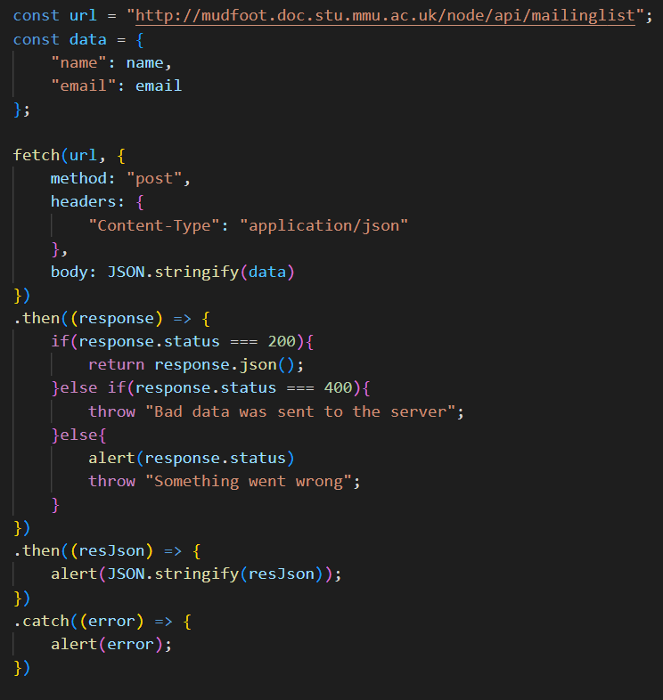
Making API requests
We can use the “fetch” library to interact with APIs (like we did last year)
Other methods exist (e.g., Axios) – feel free to use if you’d prefer
Typically, API interactions are conducted in two places:
On load of a component (e.g., ??)
On some event (e.g., ??)

Slide 6
Designing the application
Before we start implementing, we need to design our application and its components.
Today, we will be implementing the following:
Dashboard
Login
App
Router
Home
Demo…
View Article

Slide 7
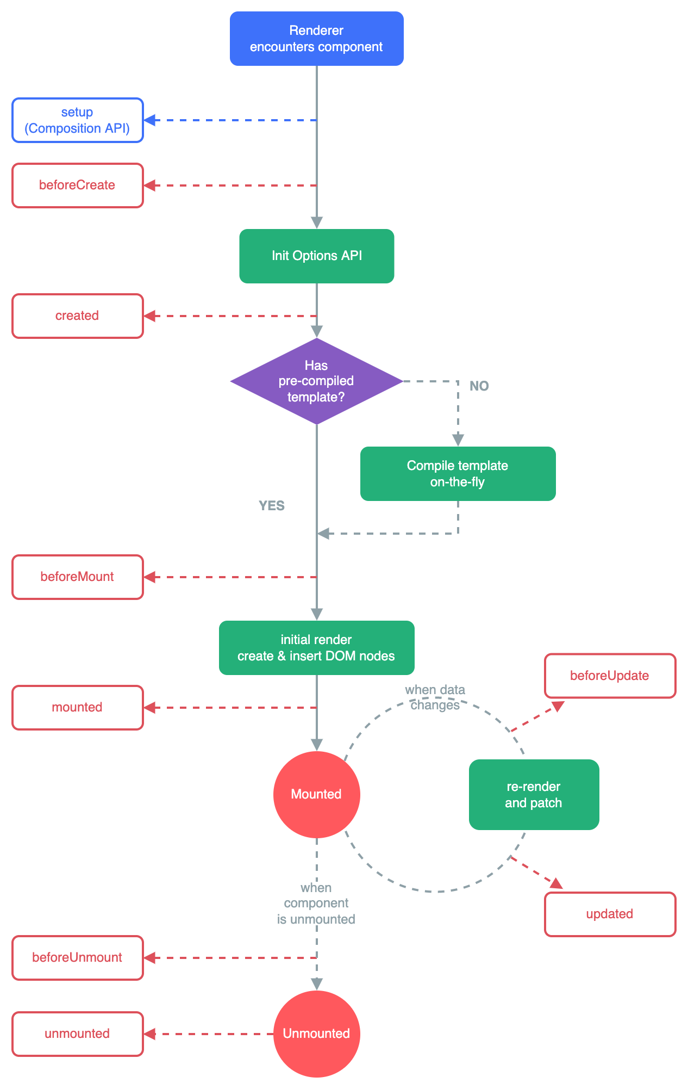
VueJS Lifecycle (a correction)
Last week I said that we will use the created() hook for getting initial data. However, perhaps mounted() would be better…
Mounted(): execute before creating the component
Use: you need to access or modify the DOM immediately before or after initial render
Created(): execute after creating the component for render

Slide 8
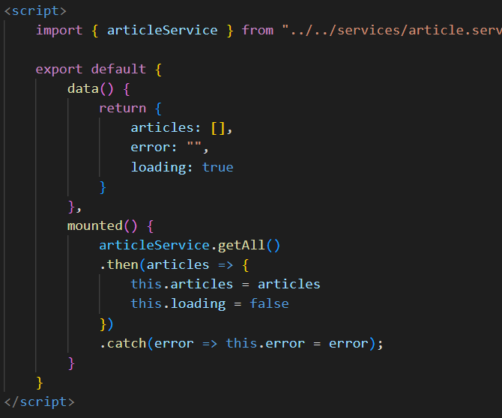
Making a GET request (Home Page)
Step 1: initialise the data (articles, error, loading)
Step 2: call the getAll() function on the articles service
Step 3: Handle successful response
Step 4: Handle error
This uses JS promises

Slide 9
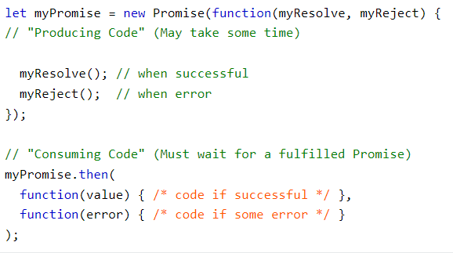
Promises
“I promise a result”
A JS object that represents the eventual completion or failure of an asynchronous operation.
Can be “pending”, “fulfilled”, or “rejected”
Promises can also be chained together

Slide 10
Promises
To simplify:
1. Try to do this
2. If it works, then do this
3. If it didn’t work, do this

Slide 11
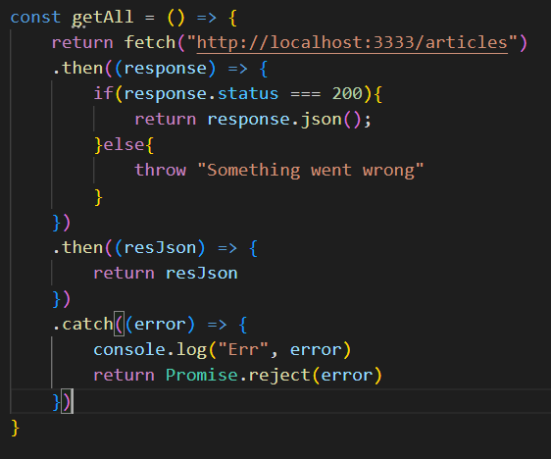
The Article service
A file to handle all of the article endpoint interactions
Write once, use anywhere
Uses the “fetch” library (no need to import)
Handle response codes
Handles errors by rejecting the promise (i.e., pass the rejection up)

Slide 12
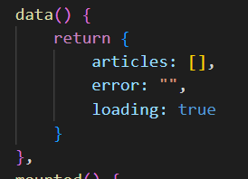
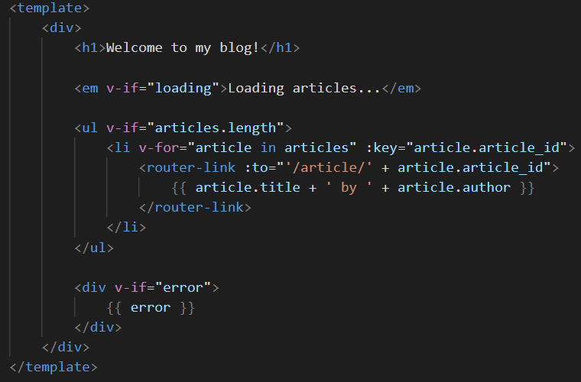
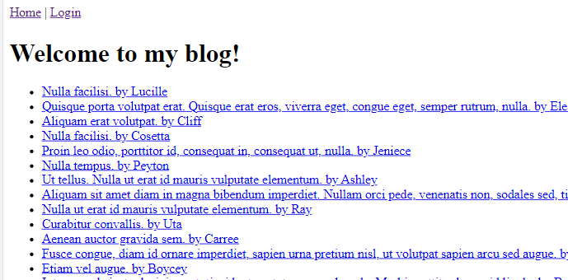
The Home Page Template

Slide 13
The Home Page Template
Linking to /article/id…
…but it doesn’t yet exist…
…so we need to create that page in our router..

Slide 14
The /article/:id page
First, create the component and add to the existing router
Note we handle path parameters similar to our back end application

Slide 15
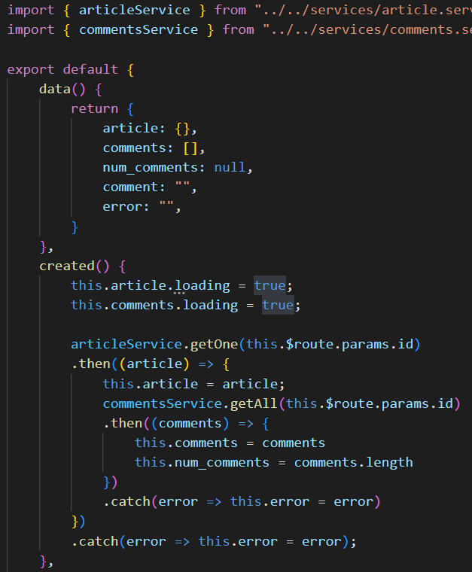
The /article/:id page
Similar to the homepage
Access the path parameter using this.$route.params.id
If successful, also get the comments
Instead of loading variable, we assign it to the array which is then overridden – slightly cleaner

Slide 16
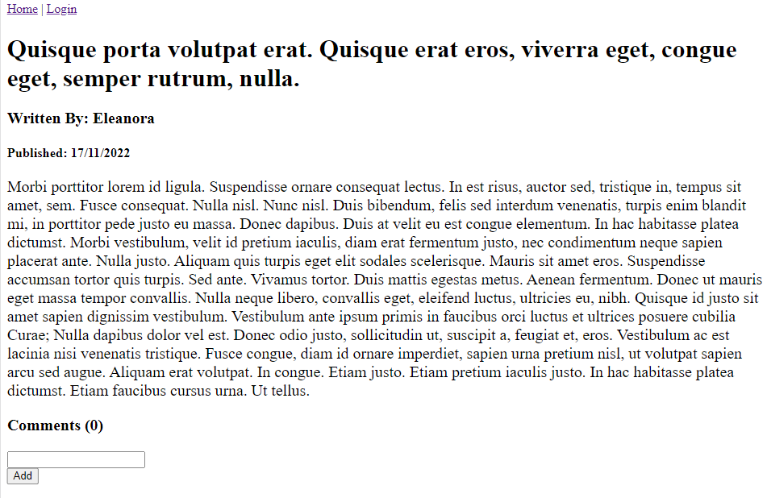
The /article/:id page
What we would like to see….

Slide 17
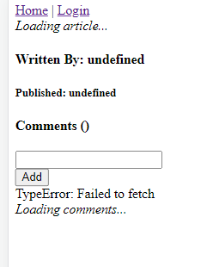
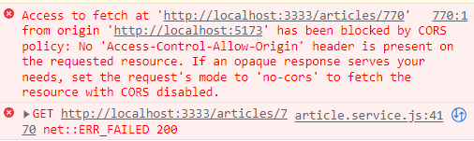
The /article/:id page
What we actually see….
You will probably see this when implementing the home page – but I think mine had cached the data when I created the slides
This error is to do with CORS…

Slide 18
Cross-Origin Resource Sharing (CORS)
“A HTTP based mechanism that allows a server to indicate any origins (domain, scheme, port) other than its own from which a browser should permit loading resources” (https://developer.mozilla.org/en-US/docs/Web/HTTP/CORS)
By default, requests from other origins are blocked for security reasons – allows you to define which HTTP methods, headers, URLs, ports are allowed to access your application

Slide 19
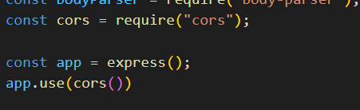
Cross-Origin Resource Sharing (CORS)
However, an in-depth look at CORS is beyond the scope of this unit, so let's just let anything through (like turning off a firewall to get around your problems)
On your back end, “npm install --save cors”
Then in your server.js file:

Slide 20
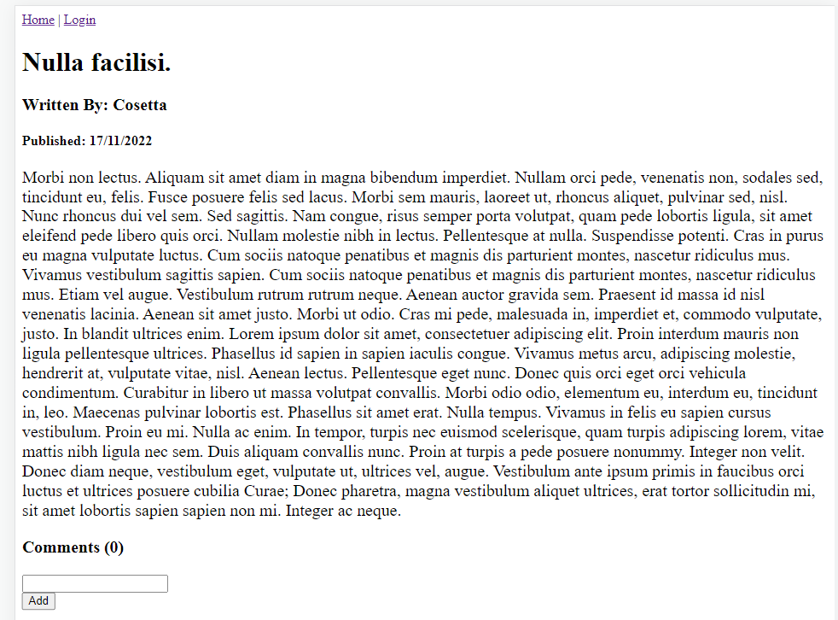
The /article/:id page
Now go back to your front-end and refresh
Beautiful!

Slide 21

Where are we up to?
Dashboard
Login
App
Router
Home
View Article

Slide 22
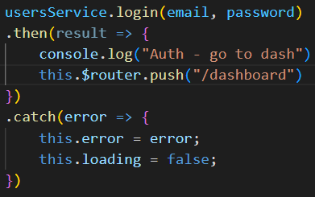
Login Form
You already have a form and validation from last week
If your validation is successful, then you can make the API call
If the call is successful (i.e., they are logged in), then send the user to the dashboard (you will need to create and add the dashboard to your router)

Slide 23
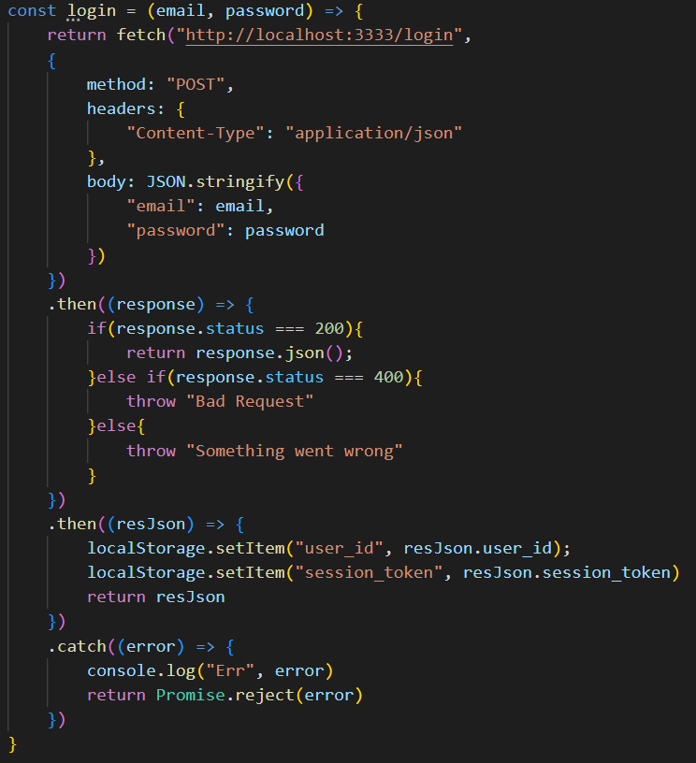
Login Form
The login function works the same way, but now we need to send an additional object with the request
We can also handle the response codes to tailor any errors/validation
If everything has worked, we use the browsers local storage to save the resulting data

Slide 24
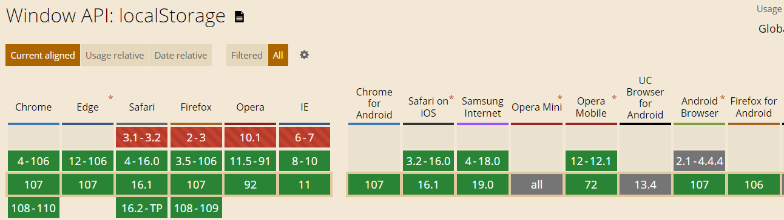
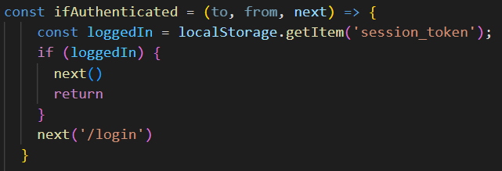
LocalStorage
Easy access to the browsers storage, no need to import
Stores key/value pairs:
.getItem(key) – returns the value
.setItem(key, value) – save a new key/value pair
.removeItem(key) – remove a key/value pair
Remember this from last week…

Slide 25
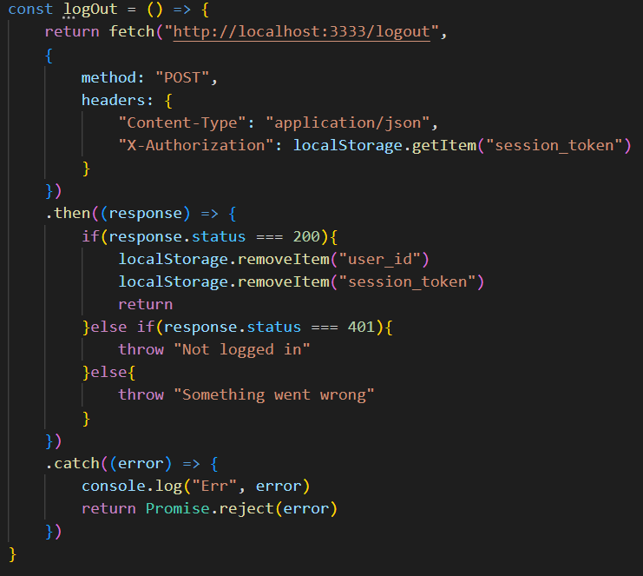
Logging out
In the dashboard, I have a log out button..
We use .getItem() to get the token for the header
If successful, then we destroy the saved data with .removeItem()
The calling function then redirects to the Home page

Slide 26
This week’s lab
In this week's lab, you will:
Implement your assignment to the same point where we are in the lecture
Have all of the tools/methods/code to complete the rest of the functionality for the assignment
Assignment Checklist:
Begin interacting with the API to provide functionality to your app

Slide 27
Questions?

